Slide 1
ROCC Clean Energy Committee
2019 Annual Report
Established Jan. 2016

Slide 2
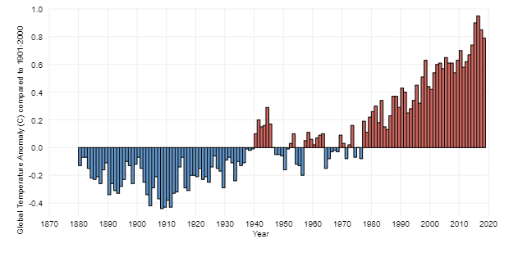
Global Surface Temperatures since 1880: 2018 – 4th hottest yr on record, behind 2015-17
The hottest 4 years on record were – the last 4 years.
The warmth in 2018 occurred in the absence of
El Niño, which is usually a factor in extreme global warmth.
https://www.climate.gov/news-features/understanding-climate/climate-change-global-temperature

Slide 3
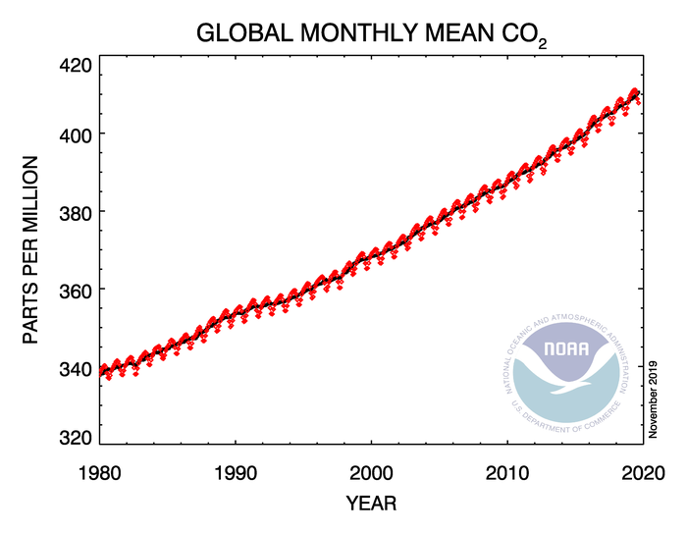
Carbon Dioxide Emissions Remain on the Rise: CO2 emissions from fossil fuel energy sources
https://www.esrl.noaa.gov/gmd/ccgg/trends/global.html#global

Slide 4
2018 Tri-State Generation – Some Progress!
Still heavily coal based with a majority of the 43 Co-Op members being very conservative – but generation is now up to 1/3 renewables
Contracted for two new renewable generation projects (104 MW wind (2020) & 100 MW solar (2023), increasing future renewable resources by 45%, and issued an RFP for a third.
New TriState CEO and potential contract changes offer some hope
Having few local options, we need to keep pushing Tri-State.

Slide 5
Tri-State is increasing the Local Renewables Cap!
Through Co-op contracts, Tri-State has imposed a 5% local renewable cap – and SMPA is at that 5% cap
Tri-State is facing pressure from a small # of large Co-ops
Kit Carson (2016) and DMEA (2019) are paying to withdraw
United & LaPlata have asked how much their withdrawal fee will be
In Nov. 2019, Tri-State member co-ops voted to raise the cap to 7%

Slide 6
2019 Colorado Legislation!!!
HB19-1261 → sets state emissions reduction targets (2005 baseline) – at least 26% by 2025, 50% by 2030, 90% by 2050
SB19-096, requires a statewide inventory of Greenhouse Gas Emissions by Sector q 1-2 years (with forecasts for 2025, 30, 35, 40, & 45)
HB19-1260, requires local governments with building codes to adopt up-to-date versions of the International Energy Conservation Code.
SB19-181, overhauling the regulation of the oil and gas industry

Slide 7
ROCC Clean Energy Committee 2019 in Review

Slide 8
Go Totally Green!
Totally Green is San Miguel Power’s newest and simplest way for you to use electricity from 100% renewable sources. Sign up once. The voluntary 1¢ per kilowatt-hour bill adjustment automatically tracks your electricity use and makes the needed investment. Your monthly bill increases by 7.4% with 100% of those funds used to help build new local renewable energy resources.
The Green Blocks program
remains available for
those with “net-metered”
accounts.

Slide 9
Ridgway EV Charging Station
Town grant written in 2016 by our committee
Two EV chargers installed December 2017
Utilization:
Town electricity cost through 9/2019 → $988
632 charges @ an average cost of $1.56/charge
ROCC is donating 1 cent/kWh → making electricity “Totally Green”
$73 donated by ROCC through 9/2019 → SMPA is working on a sign

Slide 10
Ridgway Schools
Exploring the solar option with CEO – need low-cost loans…
Toward that goal, they had a more intensive energy audit in 10/2019
New Renewable Energy elective for 2019
CEC proposed and ROCC helped by partially funding teacher training
2018 savings from prior LED installation → $14,500
16.5% reduction in electricity use with a 14.6% reduction in cost
Savings from 2016-2019 → >$55,000

Slide 11
2019 CEC Work & Ongoing Efforts
Ouray County adopted C-PACE - 9/2018
Pushed through in part by our committee work
Currently 3 local businesses have renewable projects under development
Promoting LED purchases
SMPA members spent over $6,000 buying LED bulbs
Highly leveraged due to local government and SMPA matching funds
Estimated $25,000 annual electricity costs

Slide 12
To Summarize
Sign Up!! Go Totally Green!
LED pay-back is well under 1 year
Keep pushing Tri-State!

Slide 13
ROCC Clean Energy Committee
Established - January 2016
Goals – to lower CO2 emissions through :
Education (ours and others)
Promotion of Energy Conservation
Promotion of new Renewable Energy Sources
Encourage Prudent Regulations/Legislation
We think big - but our main focus is local (Ouray County)
We now meet (roughly) monthly in the SMPA conference room
ROCC & non-ROCC members, SMPA staff & board, interested others….
We partner with others – e.g. EcoAction Partners, SMPA

